Slide 1

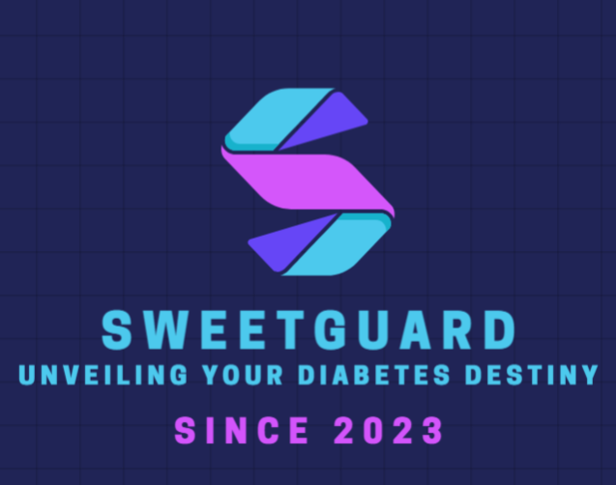

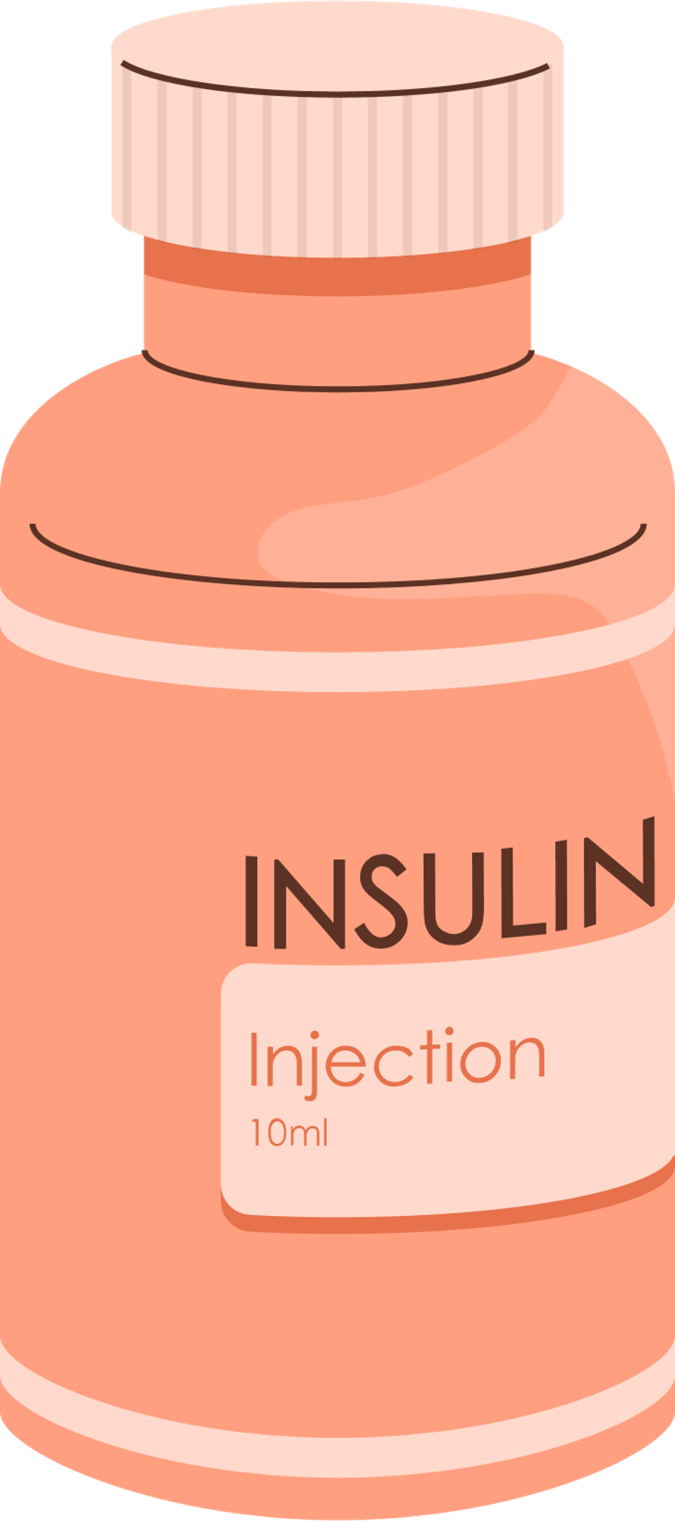
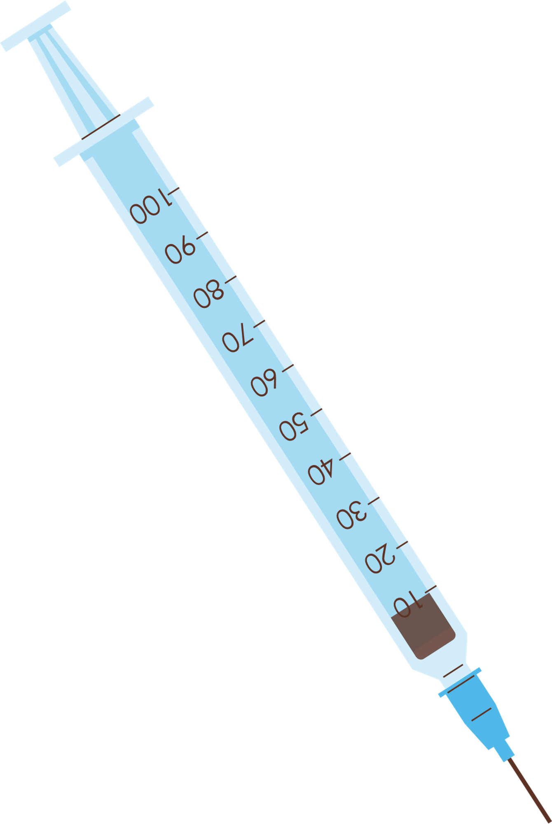


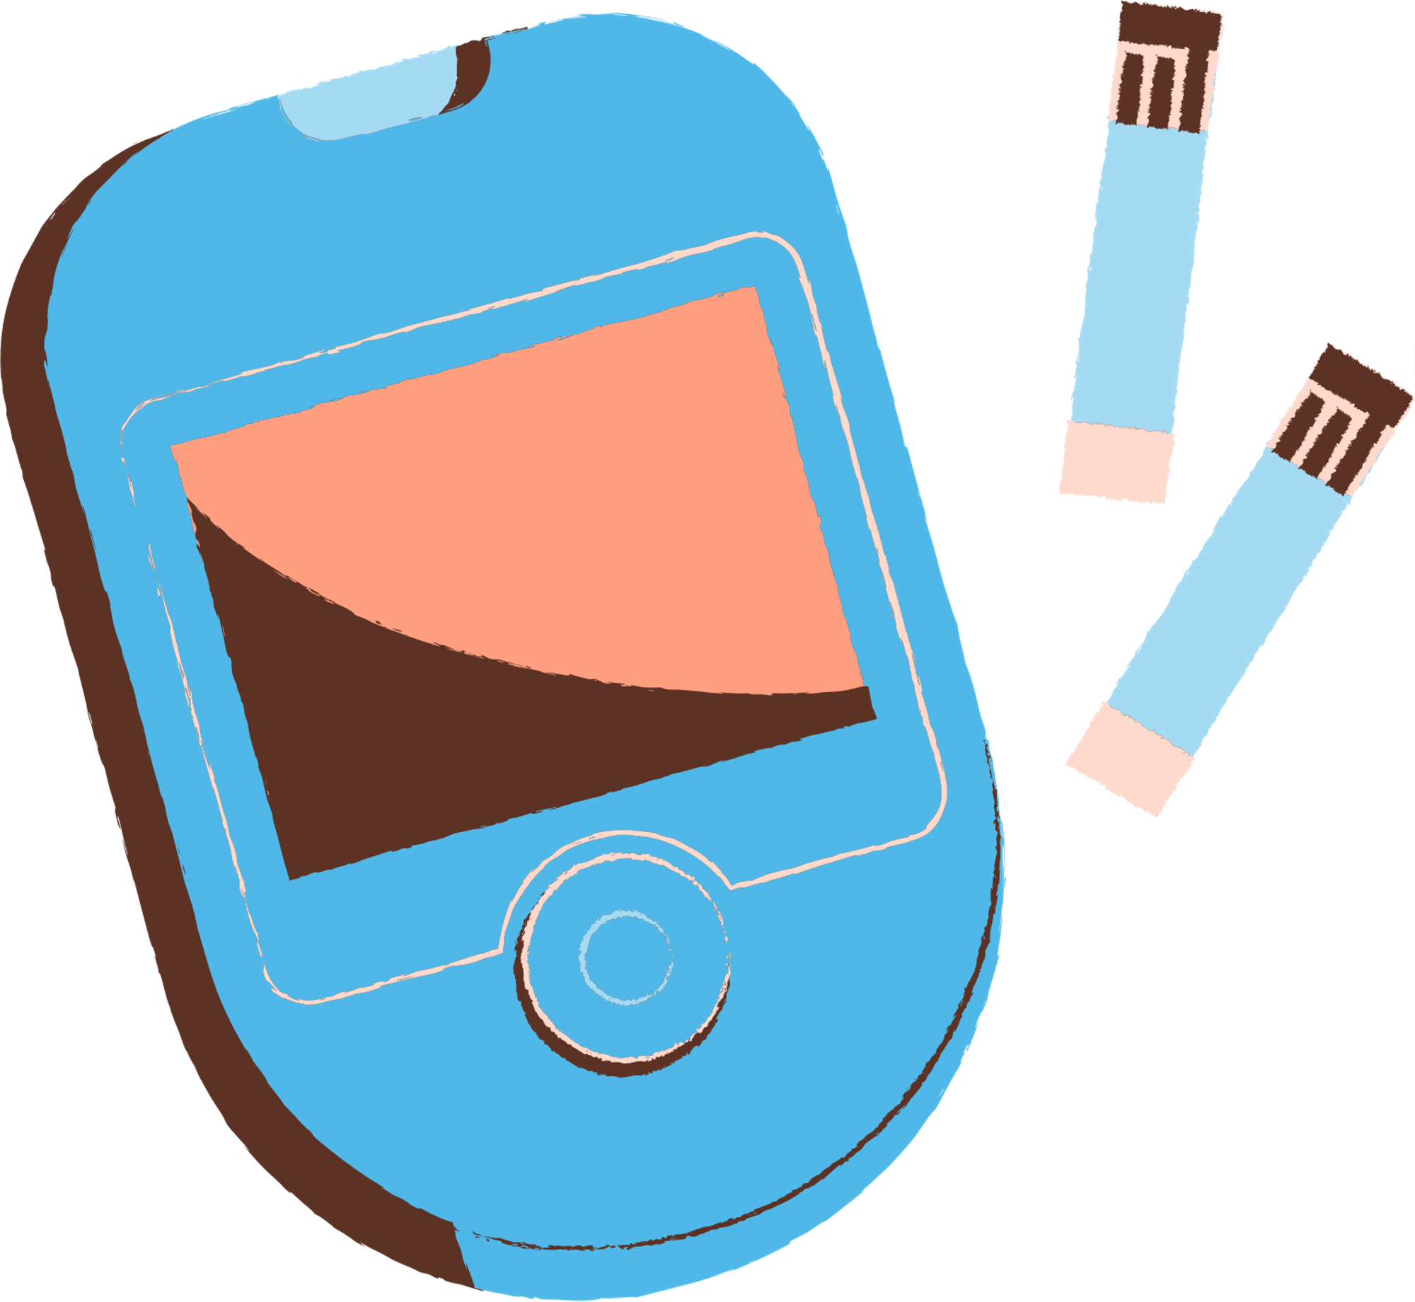
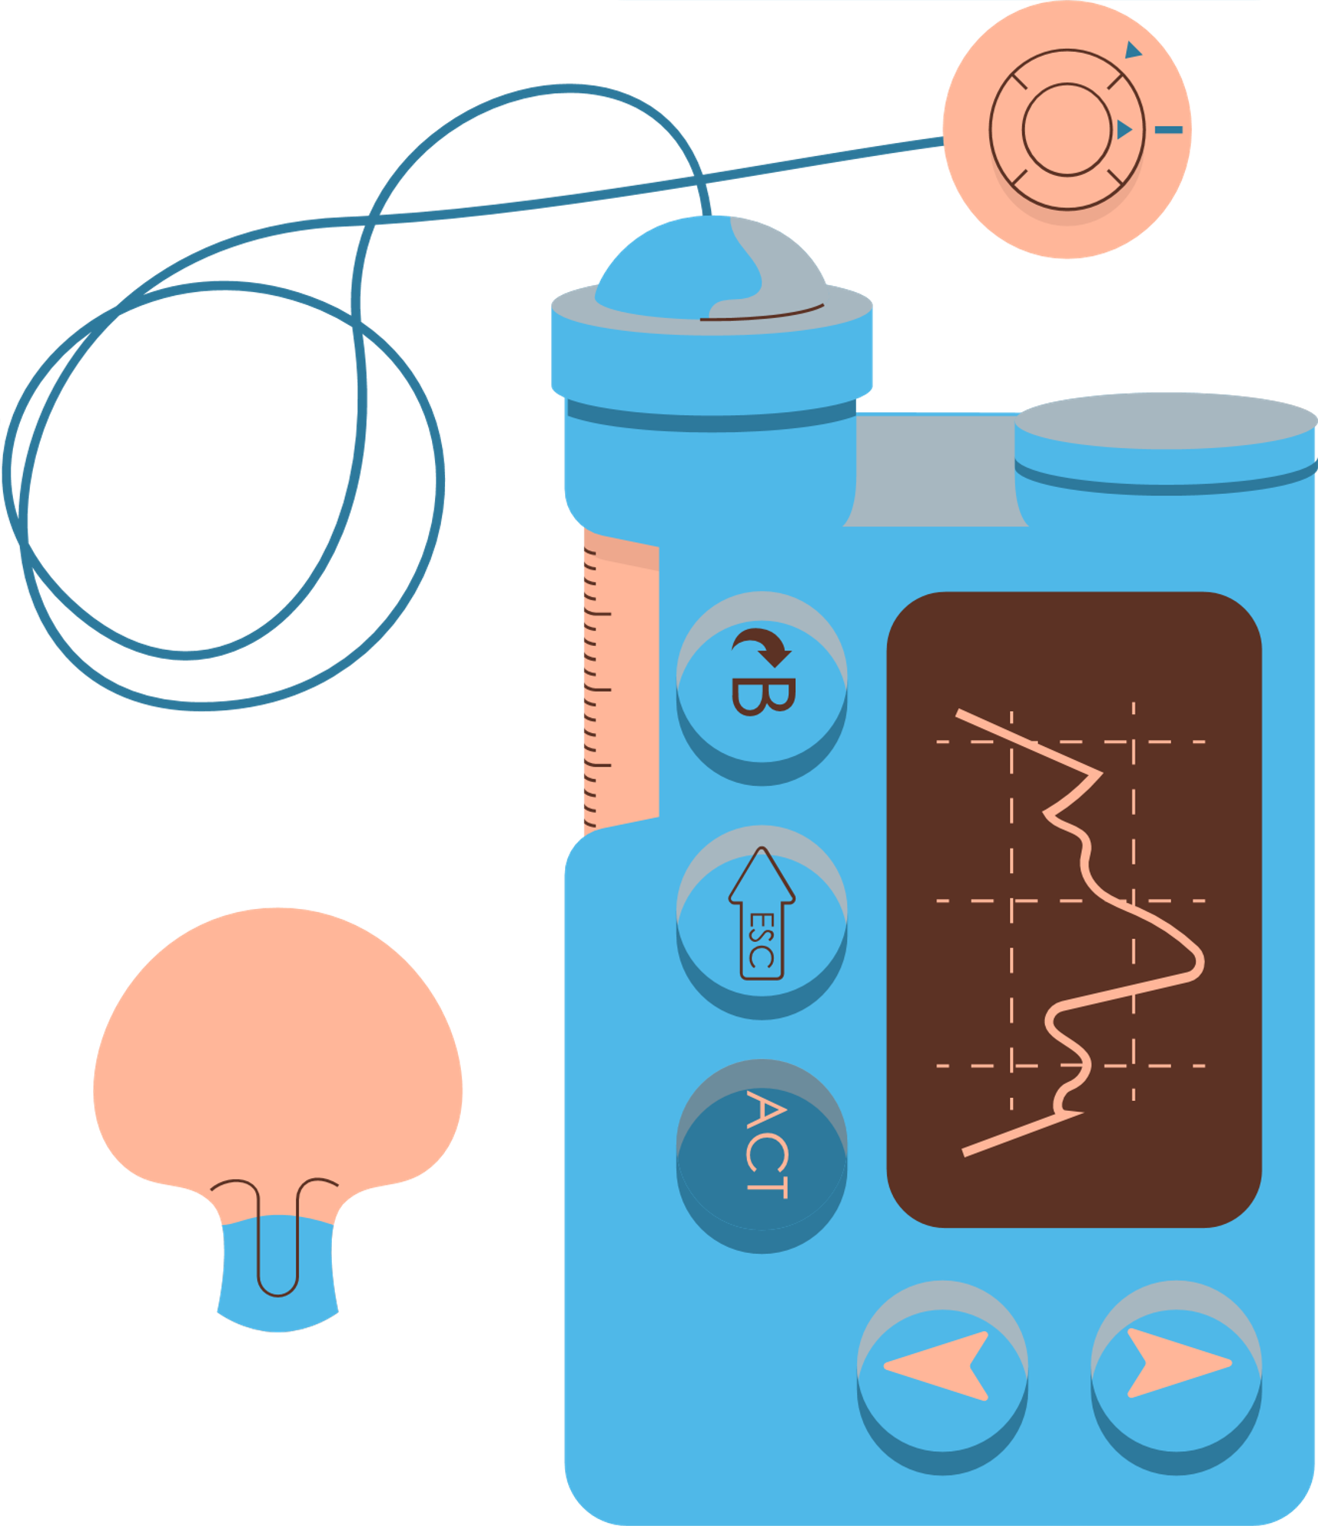
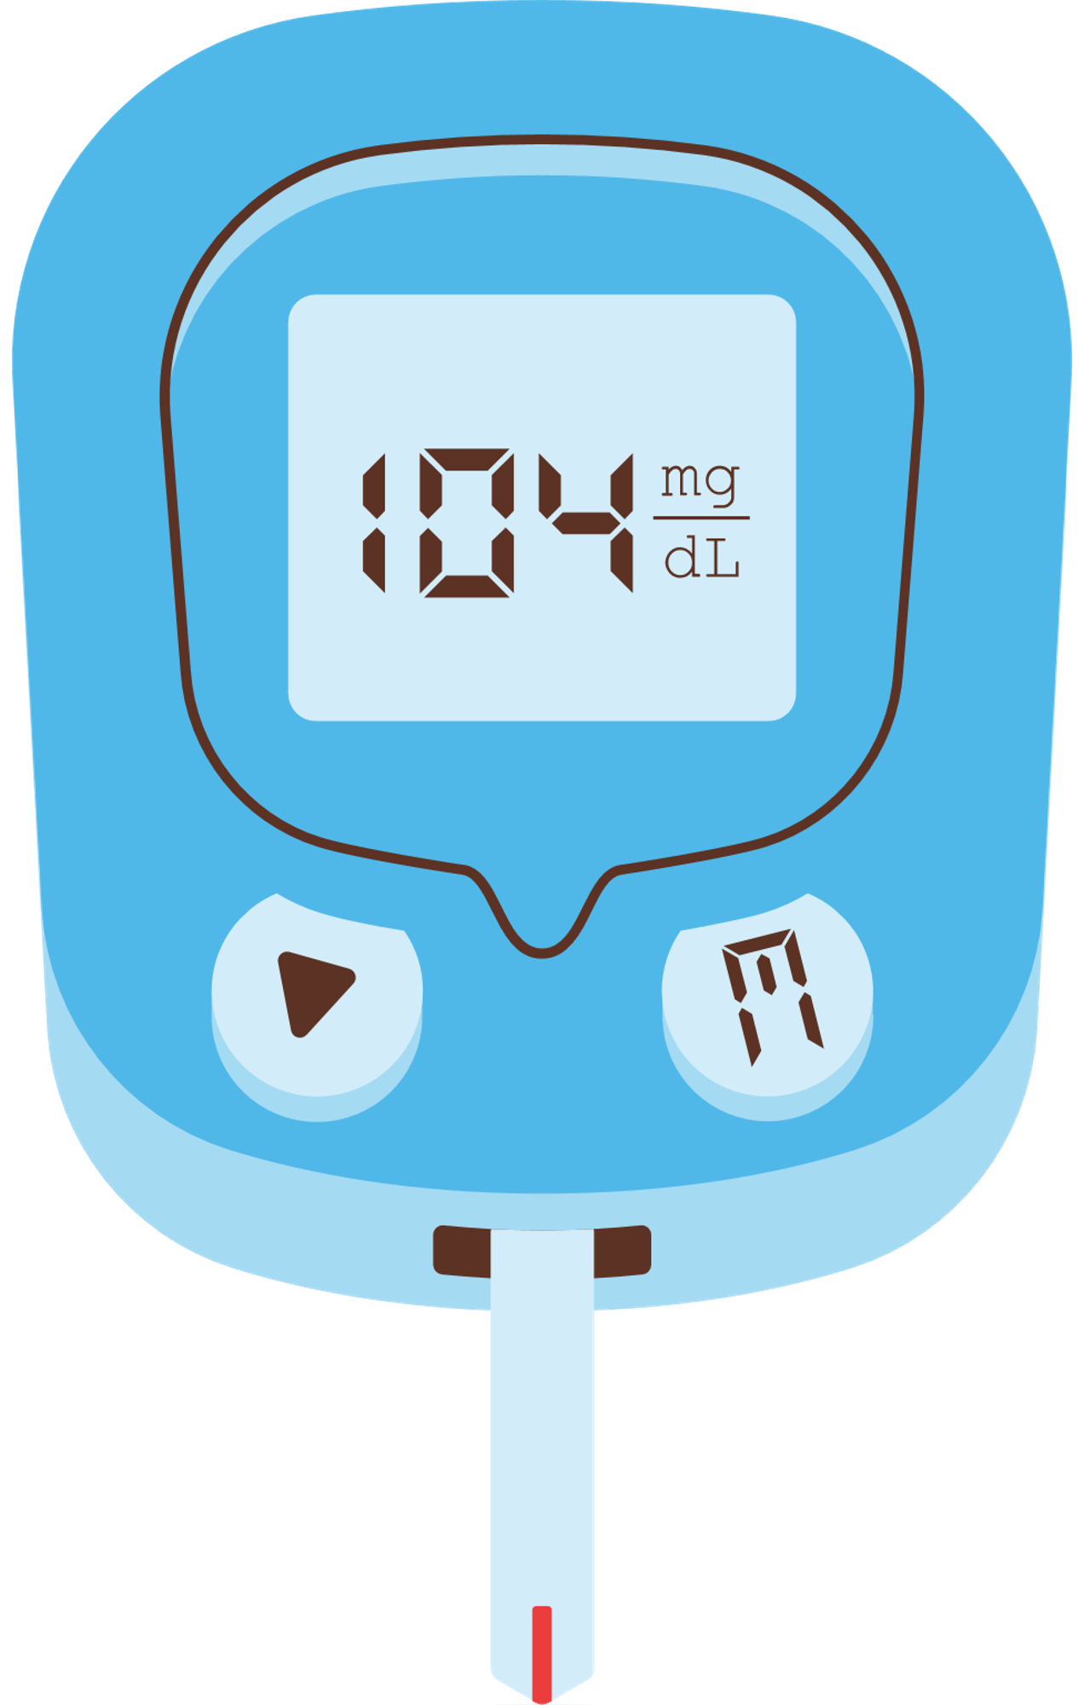

SWEETGUARD
“Unveiling Your Diabetes Destiny”

Slide 2









Ideation process
01
02
03
04
Dream It, Refine It:
Research Rhythms:
Model Magic:
Engage & Ignite:
Crafting a vision for a diabetes breakthrough!
Uncovering diabetes mysteries with clear research beats
Weaving a sleek, quantifiable risk model - the game-changer!
Igniting discussions with a live model demo – class, get ready to be amazed!

Slide 3


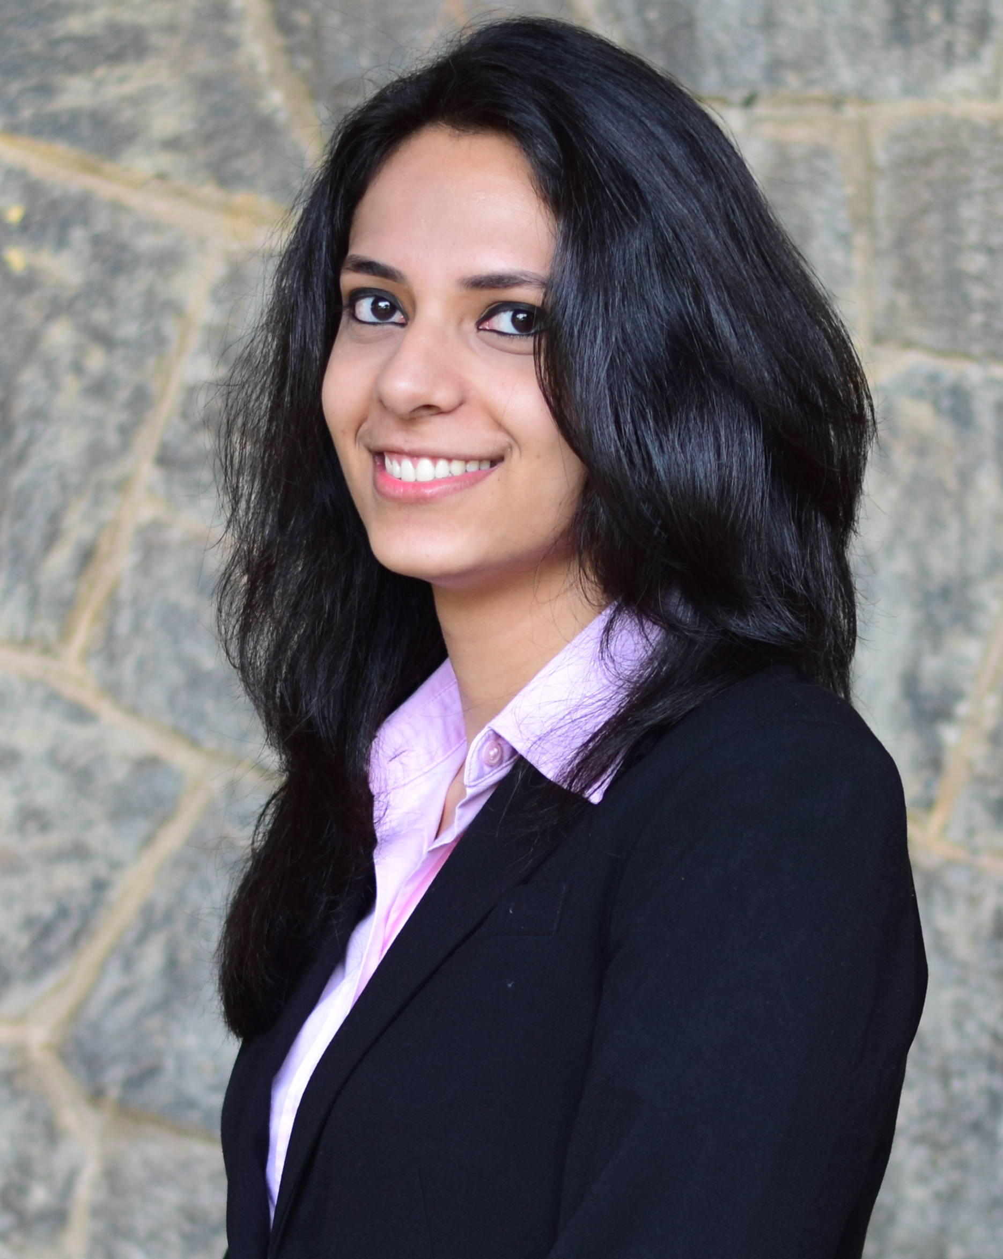

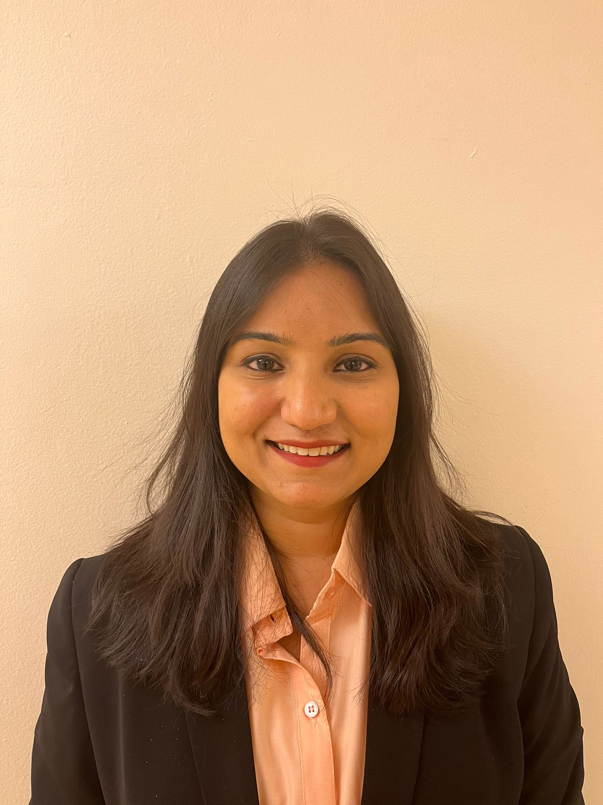
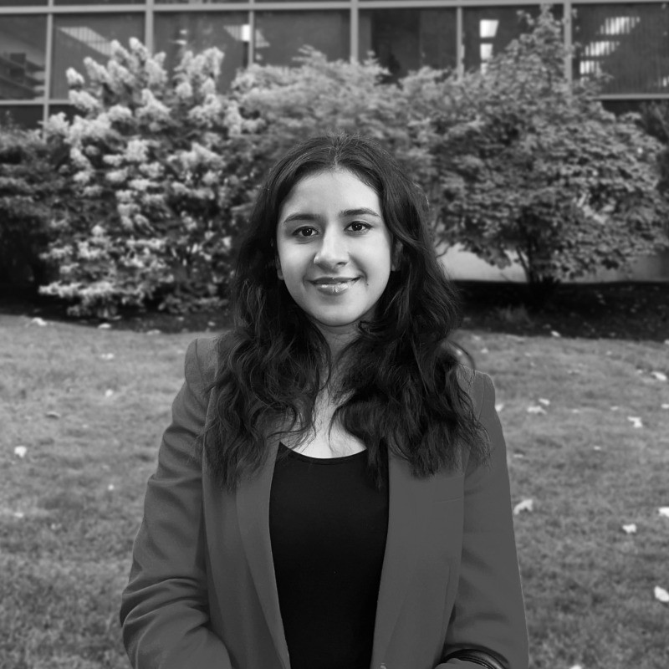

MEET OUR
TEAM
AKANKSHA NANGIA
RISHABH JOSHI
BHAKTI CHOTALIA
HIMANSHI DUA

Slide 4

Risk Factor Exploration:
01.
Can we analyze data to identify key diabetes risk factors and inform a model for accurate individualized assessment?
Project vision and mission
Quantifiable Risk Model:
02.
Can we develop a reliable model for personalized risk scores, ensuring accuracy in translating diverse factors?
Transforming diabetes management through innovative risk analysis and awareness. Our mission is to empower individuals with accurate, personalized, and accessible diabetes risk assessments.
Practical Prevention:
03.
Can we turn insights into practical prevention strategies, showcasing a live model to discuss health impact and collaboration opportunities?

Slide 5
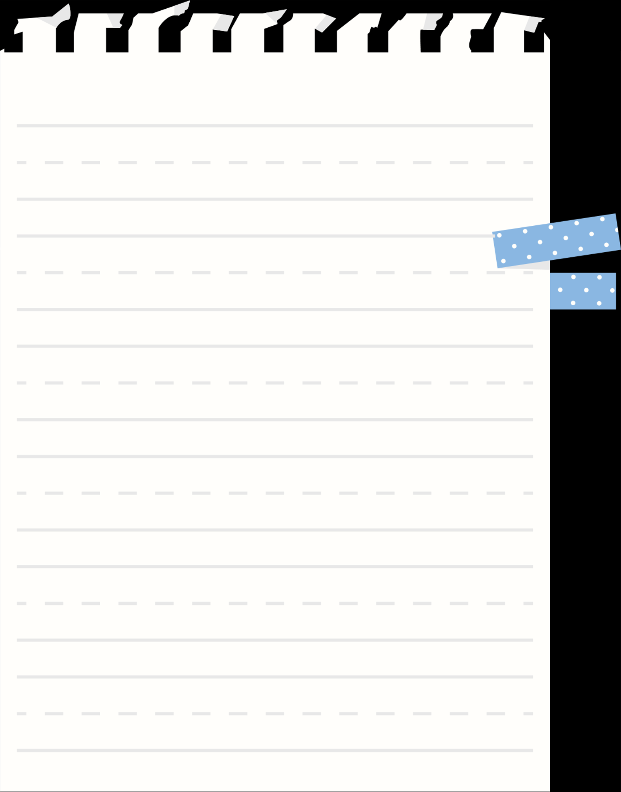
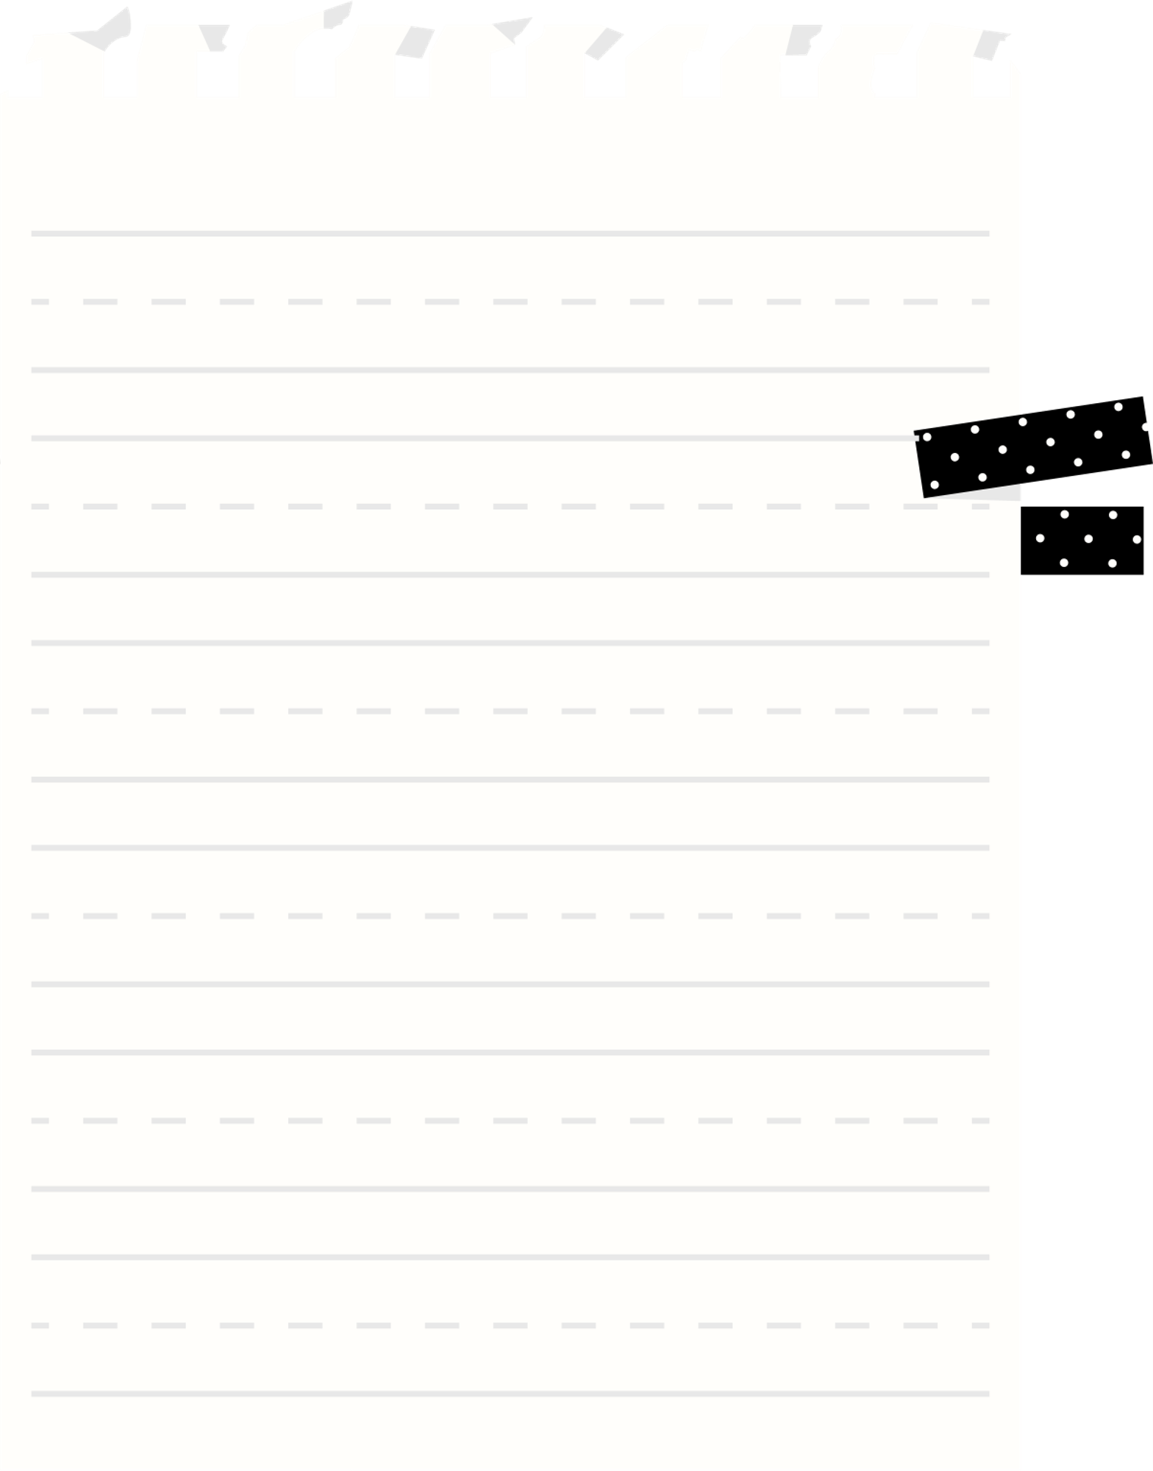
DATA SOURCES AND DATASETS
PRIMARY DATASET
SECONDARY DATASET
ACCESSEBILITY
Embarking on a journey with our Local Community Health Survey for firsthand data.
Focus areas include dietary habits, physical activity patterns, and diverse lifestyle insights.
Collecting proprietary data through community surveys for a nuanced perspective.
Leveraging the latest and previous BRFSS datasets for a comprehensive analysis.
BRFSS unveils key data on chronic health conditions, demographics, dietary habits, and lifestyles.
Comparing datasets over time amplifies our understanding and insights.
BRFSS datasets, both latest and previous, are easily accessible.
Our primary data is harvested through distributed survey forms within our chosen community.
Seamless access to both datasets ensures a robust foundation for our analysis.

Slide 6
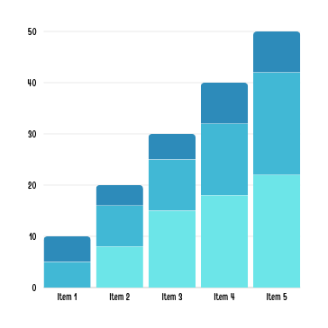
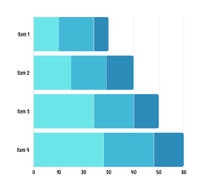
DATA CLEANING AND PREPROCESSING
Preprocessing Report
Our Strategies
DATA PREPROCESSING
We opted to concentrate solely on Massachusetts data, strategically narrowing down from 305 columns to include only the most pertinent ones, which accounted for nearly one-third of the original dataset.
01.
DATA QUALITY ASSESSMENT
Inspected data structure, checking column names and data types for potential issues.
Adjusted various target variables( such as DIFFWALK) with standardized codes.
03.
DATA TRANSFORMATION
Applied transformations to address skewness in the data, making it more suitable for certain statistical models.
Converted height and weight into meters to calculate BMI.
02.
DATA CLEANING
Selection of relevant columns
Imputation of missing values.
Handling Outliers and duplicates
04.
DATA REDUCTION
After initial transformations, revisited the dataset for a thorough evaluation.
Identified and removed irrelevant columns, such as 'PHYSHLTH,' 'MENTHLTH,' and others.

Slide 7



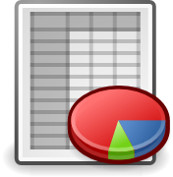











POWER OF TOOLS
PYTHON
EXCEL
POWERBI
Used for data wrangling, analysis, and modeling
Initial exploration, sorting, filtering, and manual calculations (e.g., BMI).
Dynamic Visualization Hub
Libraries: Employed Pandas, NumPy, Matplotlib, Seaborn, and Scikit-learn.
Utilized Excel formulas for quick calculations and transformations.
Enabled a more dynamic exploration of data and trends.
Challenge: Handling large datasets with Python could be memory intensive.
Challenge: Cumbersome for extensive datasets.
Challenge: Complex for real-time analysis
Solution: Optimized code for efficiency.
Solution: Excel for smaller subsets, Python for larger-scale manipulations.
Solution: Pre-processed data with Python and Excel, then imported into Power BI for visualization.
Challenges & Solutions:
Challenges & Solutions:
Challenges & Solutions:

Slide 8
Main challenges identified
Navigating Challenges: From Data Discovery to Model Precision
01.
02.
03.
Data Discovery Challenge:
Overcame hurdles in finding and accessing the diverse datasets required for analysis.
.
Data Cleaning Challenge:
Faced challenges in meticulously cleaning data, addressing missing values, outliers, duplicates, and refining for analytical robustness.
Model Accuracy Optimization Challenge:
Encountered complexities in optimizing model accuracy, balancing variables to ensure a reliable and insightful outcome.

Slide 9

RANDOM FOREST
LOGISTIC REGRESSION
ROUND 1 ACCURACY - 85.14%
ROUND 2 ACCURACY - 89.41%
ROUND 1 ACCURACY - 89.16%
ROUND 2 ACCURACY - 86.54%
Accuracy
DECISION TREE
MODELS
NAIVE BAYES
ROUND 1 ACCURACY - 82.16%
ROUND 2 ACCURACY - 79.97%
ROUND 1 ACCURACY - 41.95%
ROUND 2 ACCURACY - 75.21%
KNN
SVM
ROUND 1 ACCURACY - 84.87%
ROUND 2 ACCURACY - 87.93%
ROUND 1 ACCURACY - 87.35%
ROUND 2 ACCURACY - 89.16%

Slide 10
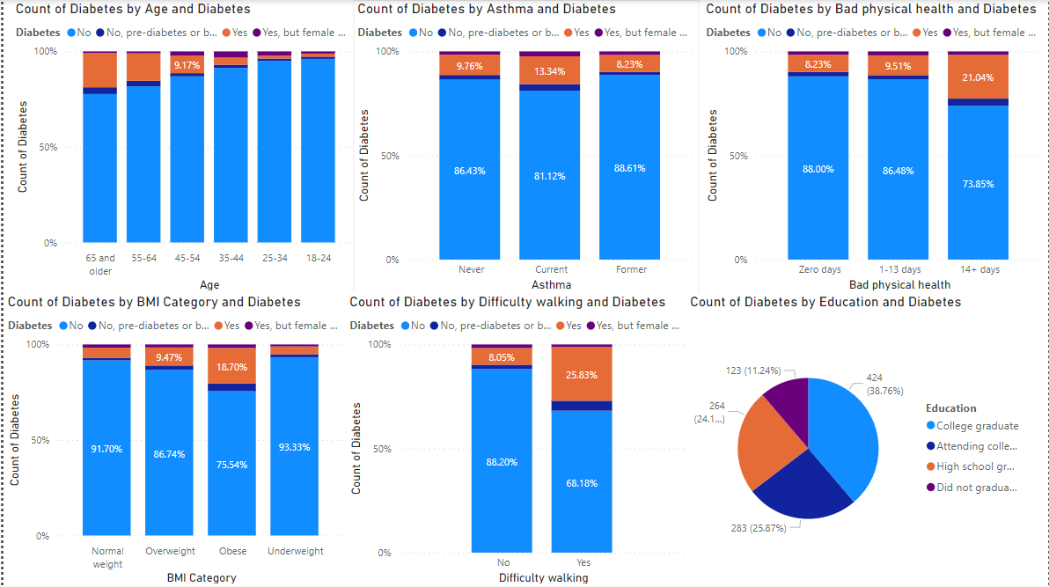
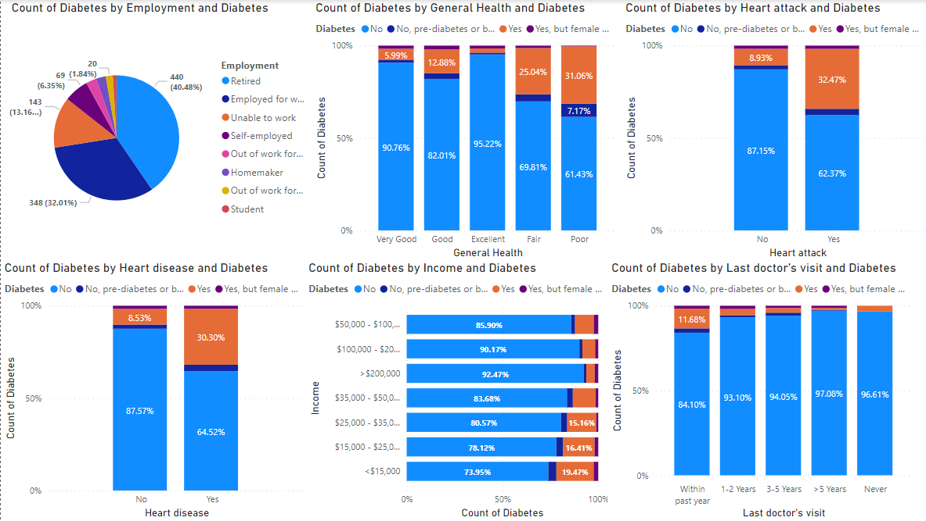
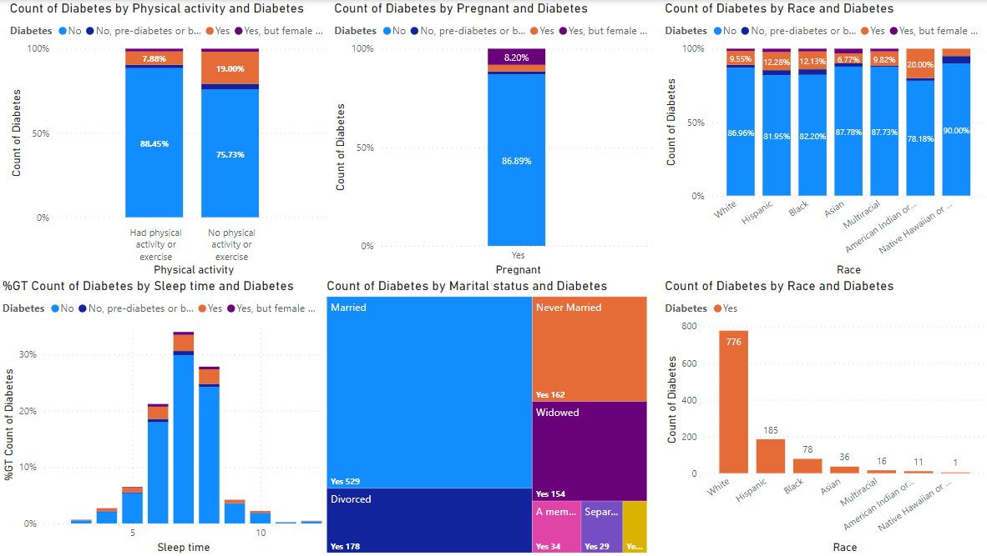
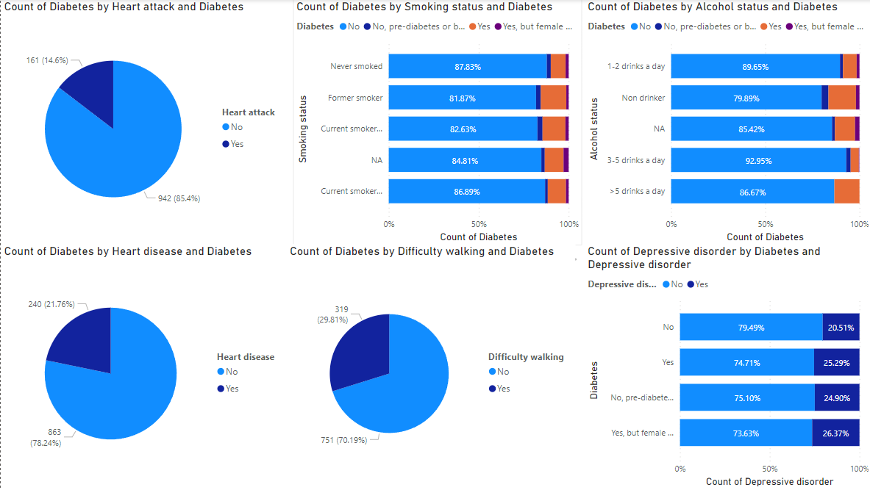
TREND ANALYSIS
As people get older or their BMI increase, they are more prone to get Type II diabetes

Slide 11







Blueprint for Risk Score Calculator
Risk Categorization:
Survey Form Submission:
Variable Collection and Bucketing:
Classified individuals into Low to Moderate Risk, High Risk, or Very High Risk categories for targeted interventions and preventive measures.
Individuals complete a detailed survey form, capturing essential lifestyle and health information.
Gathered variables, including their bucket values, for precise risk factor alignment.
Survey questions are segmented into worksheets, organized by specific risk factor buckets.
Applied a refined risk formula, converting results into a standardized 40-point scale.
Worksheet Segmentation:
Risk Formula Application:

Slide 12


Risk Assessment Methodology
1
3
First assign weights to the factors according to thier importance:
2
PURPOSE:
Risk Score Formula:
Uncover the nuanced interplay of factors contributing to diabetes risk.
Assigning weighted importance aligns risk assessment with individualized lifestyle influences.
Plan targeted interventions for at-risk populations.
BMI
Age
Race
General Health
Medical/Disease history
Physical and Mental health
Sleep time
Alcohol status
Smoking status
Risk Score =
40 * ((N1*W1 + N2*W2 + N3*W3+..........+Nn*Wn)/ Sum of W)
where N= features and W = weights

Slide 13
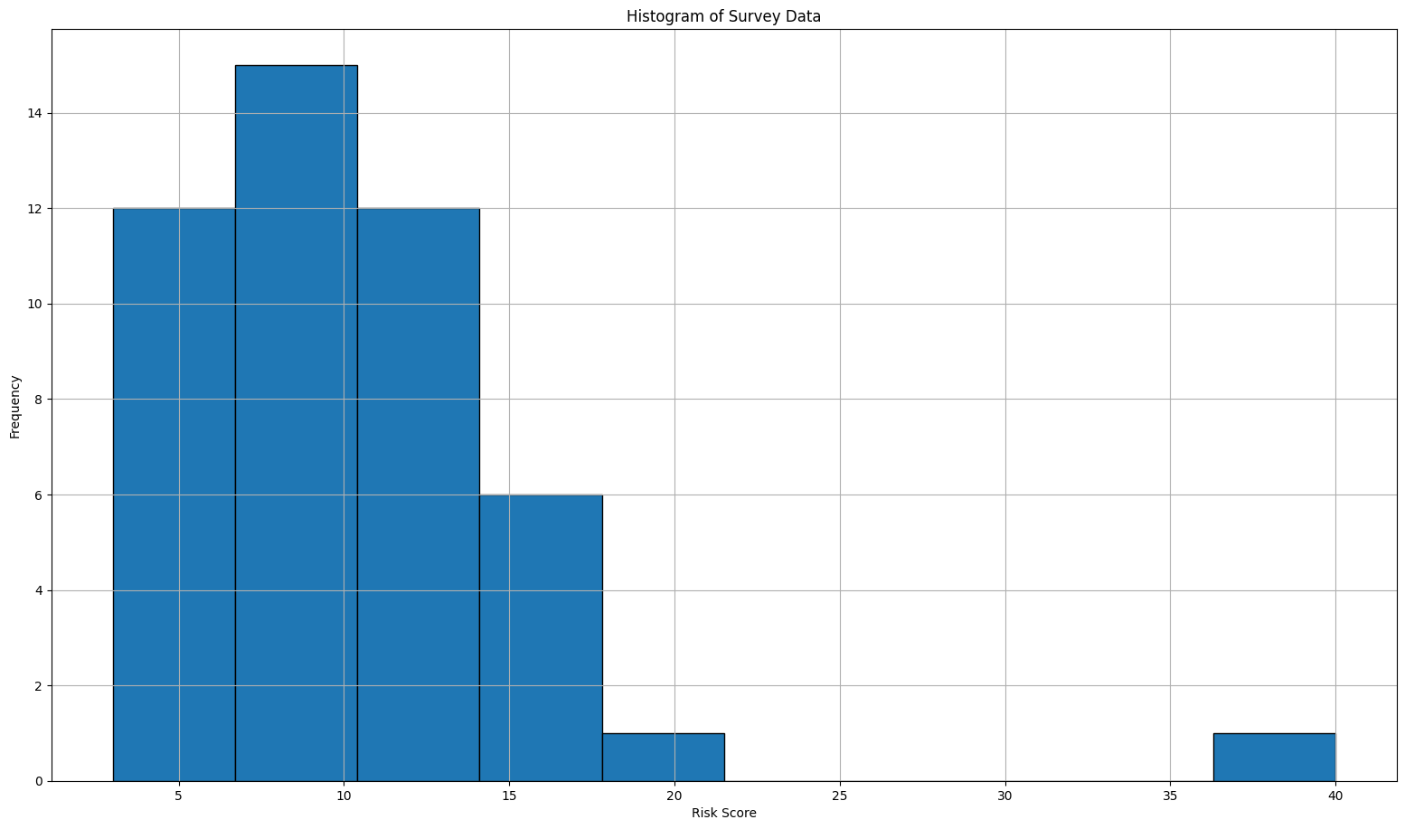
Cohort M Risk Scores Distribution
This is the histogram of risk scores of Cohort M.

Slide 14
PAMPHLET
"SWEETGUARD WELLNESS”
NOURISHING HEALTH, GUARDING WELLNESS"

Slide 15



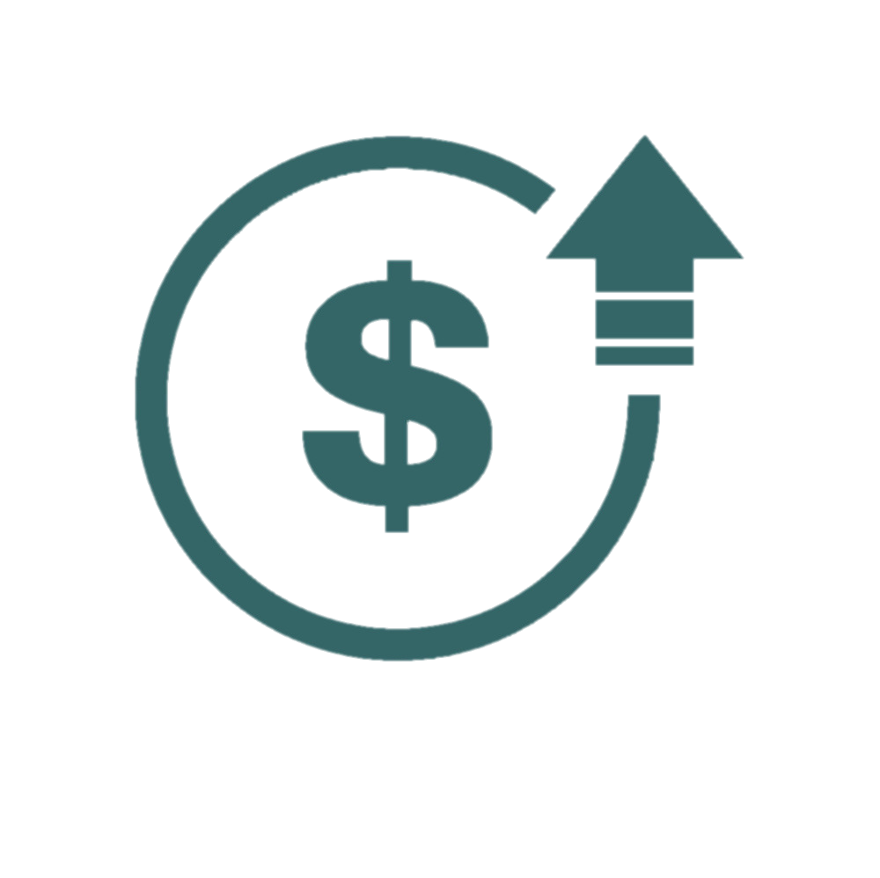
Diabetes
Awareness Month
Diabetes is a chronic medical condition where the body cannot create enough insulin or use it effectively, which regulates your blood sugar levels known as glucose
11.6%
of all adults in the U.S. have Diabetes
1 in 5
have not been diagnosed
Assessment you can
Trust
2012
9% increase in diabetes diagnoses
2022
29.5%
of all adults in the U.S. are Prediabetic
Only 2.3% of all adults in the U.S. have reported knowledge of prediabetes
8 in 10 are unaware
84%
of people with Diabetes are Type II
Type I is most often diagnosed in young adults
Type II usually develop later in a person’s life
About us:
SweetGuard stands at the forefront of preventive health, uniquely blending personal lifestyle habits with unique personality traits to forecast diabetes risk over a 10-year horizon. Our innovative approach hinges on a succinct, insightful survey, allowing us to craft risk profiles that empower individuals towards proactive health management
$413bn
Yearly medical cost of diagnosed diabetic patients
2.6
Times higher than expenditures in the absence of diabetes
Sources: CDC, Diabetes.org, BRFSS Annual survey data

Slide 16
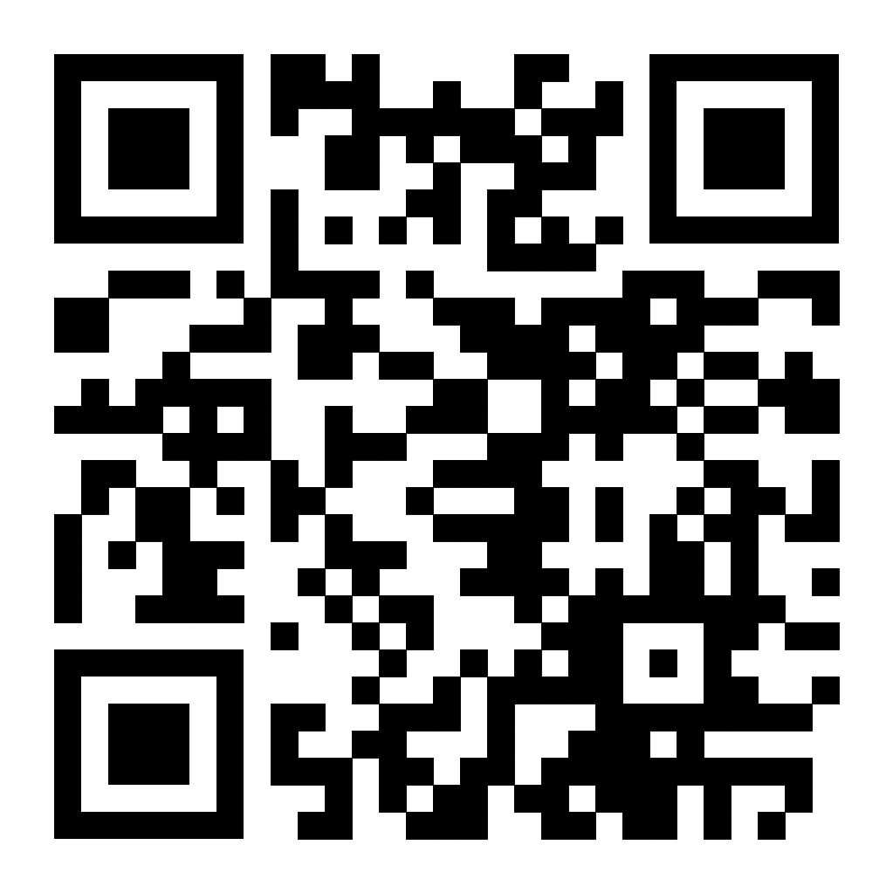







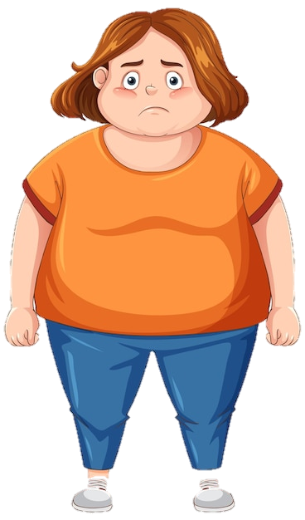
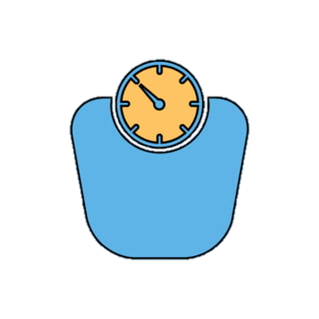
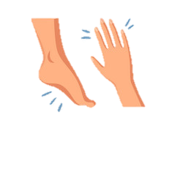




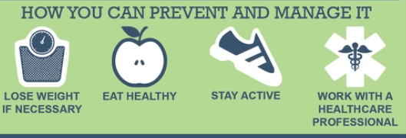




Could it be you?
Unveiling diabetic destiny
Know your risk,
Know your response
What are the SYMPTOMS?
PATIENT SEGMENTS
Check your Risk score with Sweetguard to understand your chance of diabetes over 10 years
18% above the age of 65
15% above the age of 55
Excessive hunger and thirst
Blurred vision
You’re at risk for Type-II diabetes if you:
20% people with lack of physical activity
Are overweight and/or physically inactive (Less than 3 times a week
Fatigue
Slow healing cuts
Are 45 years or older
19% with BMI more than 30
10% with BMI more than 25
Have ever had gestational diabetes (diabetes during pregnancy)
Have family history with type 2 diabetes
Sudden weight loss
Numbness in hands or feet
11% females who are pregnant
Have scored more than 15 in the Sweetguard’s risk score analyzer
Why is it DANGEROUS?
20% American Indian or Alaska Native
12% Hispanic or African Americans
Reduce the burden of Diabetes
Work with a healthcare professional to check your glucose level and blood pressure
Heart Failure
21% of diabetics suffer from Heart diseases
Stroke
25% diabetics are prone to depressive disorders
14% former or current tobacco smokers
Threaten vision and limbs
30% diabetics have difficulty walking
13% people drinking more than 5 drinks a day
Lose weight if necessary
Eat healthy and don’t smoke
Stay active

Slide 17
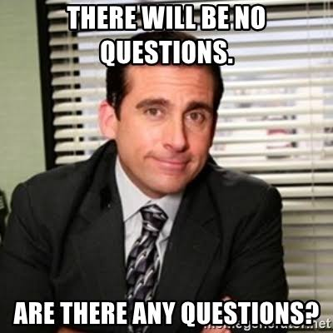

Slide 18














THANK YOU VERY MUCH!

